Slide 1


EYDS Data Engineering Technical Test
Rizky Fajar Aditya – Jr. Data Engineer
March 2025
github.com/rizkyjarr

Slide 2
EYDS Data Engineering Technical Test
Outlines
Property of Rizky Fajar Aditya
Table of Contents:
1
1st Case – SQL Query Creation
2
2nd Case – E-comm Data Warehouse design
3
3rd Case – Batching Data Pipeline design

Slide 3
1st Case Problem Solving –
SQL Query Creation

Slide 4
2nd Case Problem Solving –
Data Modelling

Slide 5
3rd Case Problem Solving –
Batching data pipeline design

Slide 6
EYDS Data Engineering Technical Test
Outlines
Property of Rizky Fajar Aditya
EYDS Data Engineering Case Overview
These cases cover about the understanding of SQL, Data Modelling, and Data Pipeline Concepts
1
SQL Query Creation
2
Data Modelling
3
Data Pipeline Design
Case Objective:
Write an SQL Query to get the top 10 customers by net total spending in the last 6 months.
Constraints:
The expected output should include:
Customer_id
Customer_name
Country
Total_spent
Unique_products_purchase
Unique_total_orders
And filtered only completed orders
Case Objective:
Designing data warehouse for e-commerce platform to track its sales and operations performance.
Tasks:
Design a star schema within the data warehouse
Handle Slowly Changing Dimensions tables
Performance Optimization (indexing and partitioning)
Provide ERD or schema design within the warehouse
Case Objective:
Build batch ETL pipeline that processes JSON and load into PostgreSQL database
Tasks and Constraints:
Extract json from local directory
Transform data using PySpark that handles missing and duplicate values, convert data types, and aggregates customer transactions.
Load the data into PostgreSQL databases

Slide 8
EYDS Data Engineering Technical Test
Outlines
Property of Rizky Fajar Aditya
1st Case Problem Solving – SQL Query Creation
I used a structured approach to solve the 1st case, including setting up containerized PostgreSQL and querying
with recent_order AS(
select
o.order_id,
o.customer_id,
o.order_date,
o.status,
oi.product_id,
oi.quantity,
oi.price,
oi.discount,
oi.tax
from orders o
left join order_items oi
on o.order_id = oi.order_id
where order_date >= '2024-09-20' and status = 'Delivered'
order by order_date desc
),
customer_spending AS(
select
customer_id,
count(distinct product_id) as total_unique_products_purchased,
count(distinct order_id) as total_unique_orders,
SUM (quantity * price) - SUM(discount) + SUM(tax) as total_cust_spending
from recent_order
group by customer_id
order by total_unique_orders desc
)
select
c.customer_id,
c.name as cust_name,
c.country,
cs.total_unique_orders,
cs.total_unique_products_purchased,
cs.total_cust_spending
from customers c
join customer_spending cs
on c.customer_id = cs.customer_id
order by total_cust_spending desc
limit 10
Setting up postgresql in docker
Create schemas within the postgresql
Generate sample data using AI
Insert data using DML commands
Perform query

Slide 9






Data Engineering Program
Final Project– Background and Study Case
Property of Rizky Fajar Aditya
Study Case: GoHailing! company is facing risks that threatens its business sustainability
Tight market competition
Revenue declining sharp
Productivity decreases
GoHailing!, a provider of on-demand transportation services, is facing intense competition due to the rise of new players with the same business model, increasing market pressure.
Go-Hailing saw its revenue declining by 35% over the past few years, significantly threatening its sustainability amid rising costs.
GoHailing’s business productivity has declined significantly compared to industry benchmarks, signaling increased customer and driver partner churn.
Go-Hailing revenue, in IDR Bn
2020 - 2024
Productivity competition, in rides per hour
2020 - 2024
Go
Hailing!
Industry Benchmark
competitor
-35%
GoHailing!
Note: The case study and data presented in this slide are hypothetical and created for illustrative purposes only
9
Final Project– Data Engineering

Slide 10



Data Engineering Program
Final Project– Background and Study Case
Property of Rizky Fajar Aditya
Three project deliverables for Data Engineer were set to optimize building data pipeline
Result effectiveness
Build automation logic flow
As a data engineer, it’s essential to:
Ensure the data engineering design is well implemented
Ensure the data generated by the pipeline is accessible and usable for analyst or relevant stakeholders
Enabling data-driven decision making by providing actionable insights through well-structured and reliable data
Ensure data privacy is secure
Design pipeline architecture
Designing automation logical flow within the data pipeline architecture, for example:
What happens if error happens when ingesting the data?
What needs to be done if there’s any datatype mismatch between database and data warehouse?
What would happen if the required table has not existed in data warehouse?
Designing pipeline that’s robust and scalable to meet business needs:
Technology stack selection: script language, data warehouse, transactional database, orchestration tools, etc
Data Processing: ELT or ETL, etc.
Dimensional data model: Star Schema, Snowflake, etc
Data ingestion method: Batch, stream, etc.
10
Final Project– Data Engineering

Slide 11








Data Engineering Program
Final Project– Development Cycle and Process
Property of Rizky Fajar Aditya
1st project deliverable: Design Pipeline Architecture
Postgre
Data Warehouse: Google’s BigQuery
Source Data
Relational DB
Source Layer
Dataset: dwh_hailing_source
Preparation Layer
Dataset: dwh_hailing_staging
Facts and Dim Layer
Dataset: dwh_hailing_facts
Marts Layer
Dataset: dwh_hailing_marts
customer
Customer_src
Customer_stg
Star schema
model
Dim_customer
Mart_cust_rides_daily
driver
driver_src
driver_stg
>
>
>
>
Dim_driver
vehicle
Vehicle_src
Vehicle_stg
Mart_driver_loyalty_mgmt
Fact_rides
ride
Ride_src
Ride_stg
ELT Ingestion using:
Transformation using:
Data Processing: ELT
Dimensional model: Star Schema
Ingestion Method: Batching D-1
Data flow
Orchestrated using:
>
Apps containerized in:
11
Tech Stack
Final Project – Data Engineering

Slide 12

Data Engineering Program
Final Project– Development Cycle and Process
Property of Rizky Fajar Aditya
2nd project deliverable: Automation logic flow
DAG_NAME: DAG1_load_to_postgre.py | OBJECTIVE: Generate data and load to PostgreSQL relational database
Task 1: Ensure table existence in PostgreSQL
Task 2: Generate data and load to PostgreSQL/DB
Start
Check table existence
Table exist?
Generate data:
Customer
driver
Fetch driver_id
Generate data:
vehicle
Y
N
Generate data:
ride
Fetch:
Driver_id
Cust_id
.sql file found?
Look for .sql file for table creation
N
Discord alert refer to Appendix 2
.sql file contains DDL commands – refer to Appendix 1
Insert data to DB:
Customer
Driver
Vehicle
ride
Y
Insert error?
Y
Execute .sql file
N
Execute error?
Create table in DB
Y
N
Data loaded to DB
End
12
Yes
No
Send error/retry alert to discord
Last process in a task
Final Project– Data Engineering
Y
N

Slide 13
Data Engineering Program
Final Project– Development Cycle and Process
Property of Rizky Fajar Aditya
2nd project deliverable: Automation logic flow
DAG_NAME: DAG2_load_to_bigquery.py | OBJECTIVE: FETCH data from PostgreSQL and UPSERT to BigQuery
Task 1: Ensure table existence in BigQuery
Task 2: Extract data and push DF to XCOM
Task 3: Pull DF from XCOM and Upsert to BQ
Start
Check table existence
Fetch data from postgre tables
Has incremental col?
Pull attempt json from XCOM
JSON found?
N
Y
Y
N
Y
Get schema from postgres
N
Table exist?
Fetch only D-1 data
Fetch all
(SELECT *)
Convert back to DF
Retrieve JSON
Return schema
Has partition field?
Return Dataframe (DF)
DF NONE?
Load data to temporary staging table
Merge with the target table
Y
Y
N
N
Create table with partition in BQ
Create table without partition in BQ
Convert df to json
DF Empty?
N
Delete staging/temporary table
Skip
Table created in BigQuery
Push json to XCOM
End
13
Yes
No
Send error/retry alert to discord
Last process in a task
Final Project– Data Engineering
Y
N

Slide 14
Data Engineering Program
Final Project– Development Cycle and Process
Property of Rizky Fajar Aditya
2nd project deliverable: Automation logic flow
DAG_NAME: DAG3_dbt_run_dwh.py | OBJECTIVE: Data transformation for raw data to business-level data in DWH
Pre-requisite:
Task 1: dbt_run_staging_models
Task 2: dbt_run_facts_models
Task 3: dbt_run_marts_models
Start
Start
Look for profiles.yml
Build dbt using Docker
N
Profiles found?
Setting BigQuery crendetials
Run dbt models/facts
Look for models/marts
N
Y
found?
Look for dbt_project.yml
Setting profiles.yml
Y
found?
N
Y
Setting dbt_project.yml
Look for models/staging
found?
found?
Y
N
N
Y
Run dbt models/marts
Setting macros and models
Run dbt models/staging
Look for models/facts
End
End
14
Yes
No
Send error/retry alert to discord
Last process in a task
Final Project– Data Engineering
Y
N

Slide 15
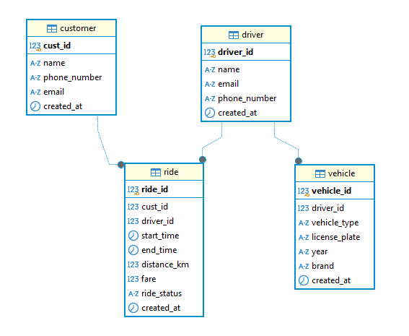
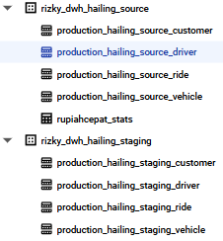
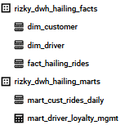
Data Engineering Program
Final Project– Background and Study Case
Property of Rizky Fajar Aditya
How well did the data pipeline design perform after implementation?
It performs well, ensuring seamless data ingestion into the warehouse and transforming raw data into business-ready insights
Data Generation
Data Warehouse Modelling
Fulfillment of business needs
Successfully generate and load data into PostgreSQL, as well as building relationships between tables – all orchestrated using Airflow
Send discord alert if either error or retry in logic automation (refer to appendix-2)
Successfully executed ELT process, enabling incremental data ingestion from PostgreSQL to BigQuery using upsert method.
Transformed data across layers from source to mart, ensuring business-ready insights. Implemented a star schema in facts layer to optimize analytical performance
The data can answer the questions that are asked in project’s background, such as:
50% of rides were cancelled.. need further investigations..
438.2$ in potential revenue was lost due to cancellations
150 drivers were registered within the database..
15% of drivers are not generating any revenue.. Need to stimulate for retention…
Fig 1. ERD in PostgreSQL
*Data as of 12th February 2025
15
Fig 2. Dataset in BigQuery
Final Project– Data Engineering

Slide 16
Final Project - Web Scraping Using Selenium
Github: https://github.com/rizkyjarr/final-project-purwadhika

Slide 17
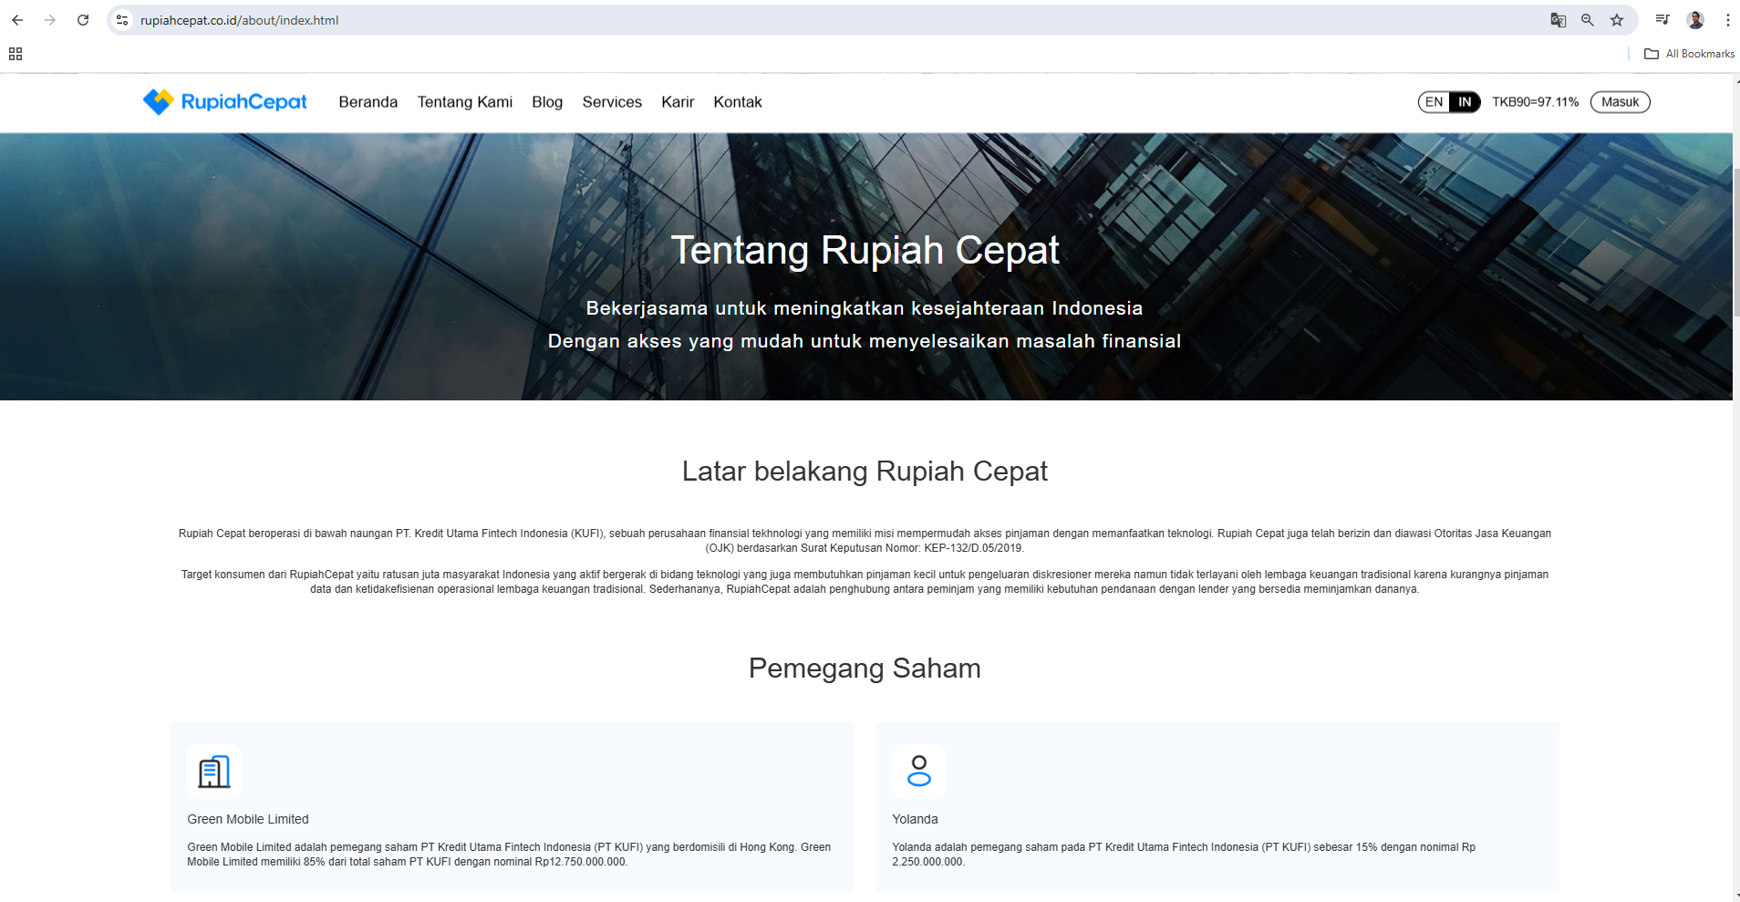
Data Engineering Program
Final Project– Background and Study Case
Property of Rizky Fajar Aditya
Study Case: Web Scraping dynamic website of Rupiah Cepat
Project Objective: Perform web scraping from one of P2P lending website (RupiahCepat) and load to Data Warehouse (BigQuery)
17
Final Project– Data Engineering

Slide 18
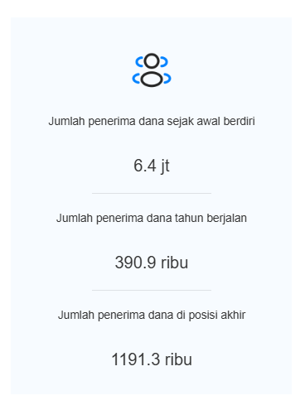
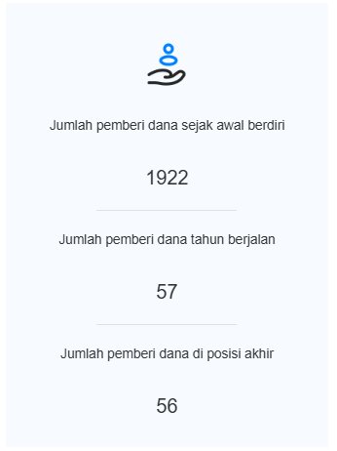
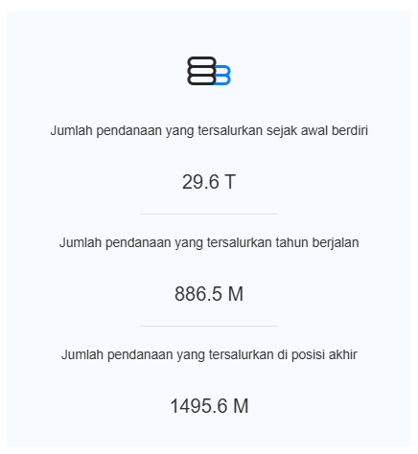

Data Engineering Program
Final Project– Development Cycle and Process
Property of Rizky Fajar Aditya
Website scraping deliverable: Design Pipeline Architecture
>
Data flow
Tech Stack
Data Source: Rupiah Cepat’s website statistic
Data Warehouse: Google’s BigQuery
Remarks:
Facts and Dim Layer
Dataset: rizky_dwh_hailing_source
Data Processing: ETL
Insert new row if there’s any changes from the website
>
>
Rupiahcepat_stats
Scraped using:
Orchestrated using:
Automation logic flow
Y
N
Start
Ensure if table exists
Table found?
N
Create table in BigQuery
Connect remote webdriver
Find element and try fetching
Element found?
Y
End
Drop staging table
Merge staging table with target table
Load data to staging table in BQ
Return as DF
Map data to column headers
18
Final Project – Data Engineering

Slide 19
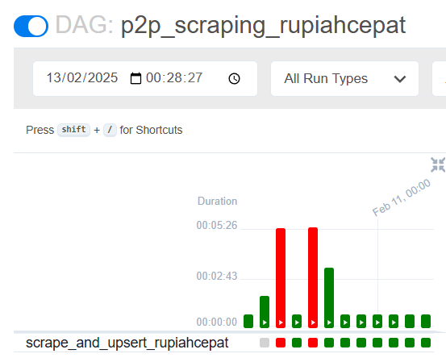
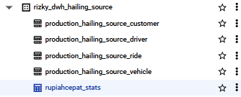
Data Engineering Program
Final Project– Background and Study Case
Property of Rizky Fajar Aditya
How well did the data pipeline design perform after implementation?
Data successfully scraped using selenium, and upsert to data warehouse – all orchestrated using Airflow
If there’s any changes in website, it will insert a new row of data and set the old data inactive in is_active column
Fig 1. Data Preview in BigQuery
Fig 2. Table preview in BigQuery dataset
Fig 3. DAG4 Historical Task Logs
*Data as of 12th February 2025
Final Project– Data Engineering
19

Slide 20
Property of Rizky Fajar Aditya
Thank you!
Any feedback would be very much appreciated ☺
Github: https://github.com/rizkyjarr/final-project-purwadhika

Slide 21
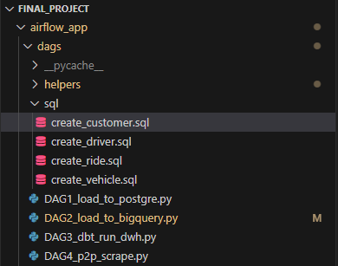
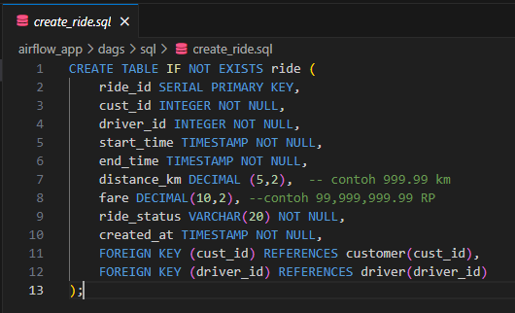
Data Engineering Program
Final Project– Background and Study Case
Property of Rizky Fajar Aditya
Appendix 1 – SQL FILES
Fig 1. SQL folder location
Fig 2. Code example
21
Final Project– Data Engineering

Slide 22
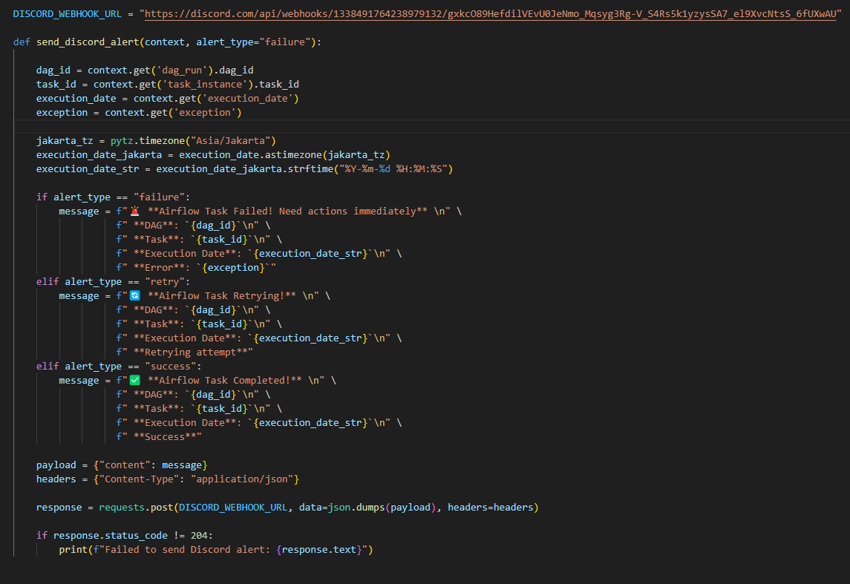
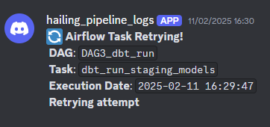
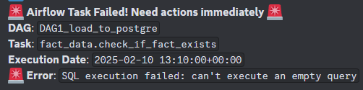
Data Engineering Program
Final Project– Background and Study Case
Property of Rizky Fajar Aditya
Appendix 2 – Discord Webhook Alert
Fig 1. Error and retry alert on Discord
Fig 2. Discord alert’s script
22
Final Project– Data Engineering

Slide 23
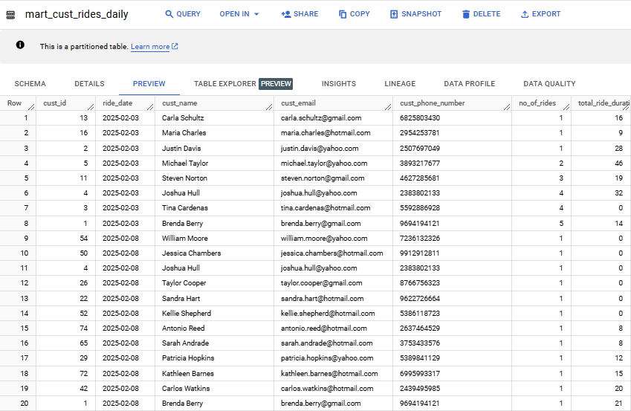
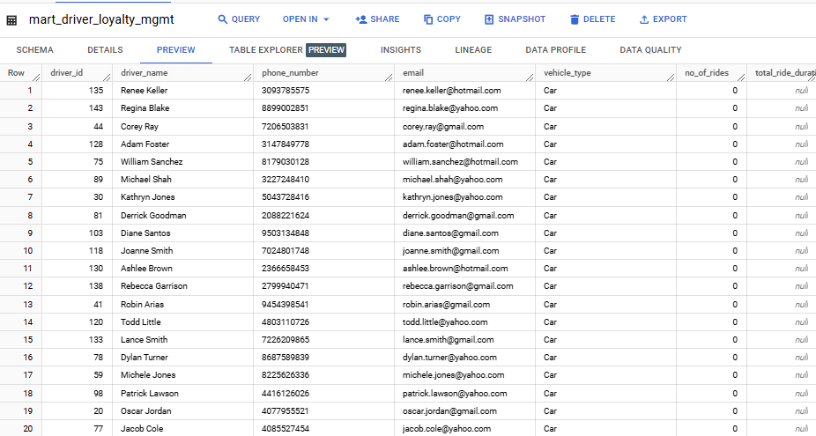
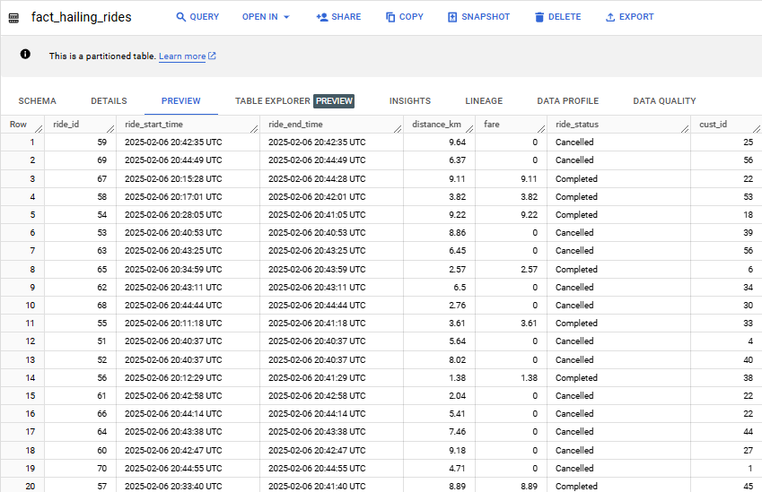
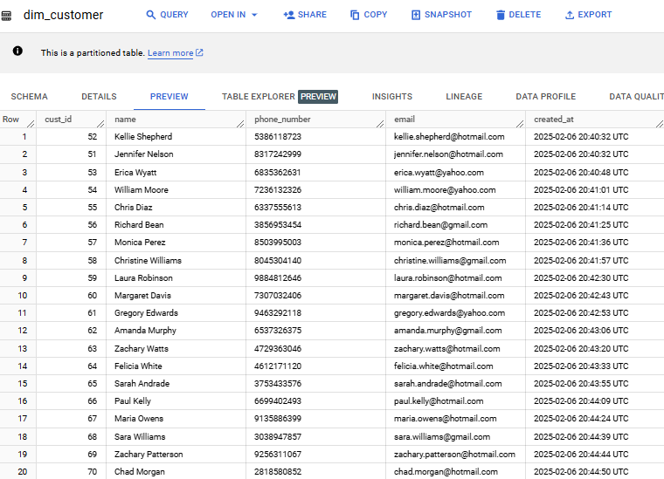
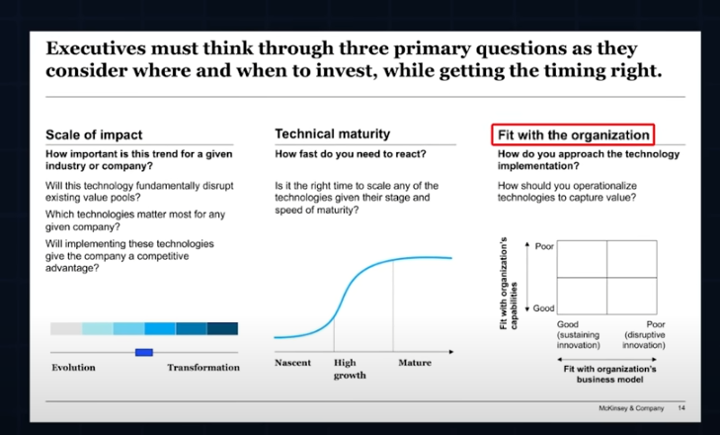
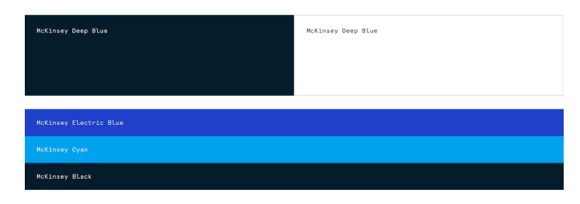
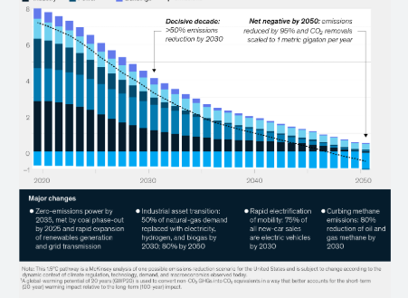
Data Engineering Program
Final Project– Background and Study Case
Property of Rizky Fajar Aditya
Appendix 3 – Data Preview in BigQuery
Fig 1. Mart_cust_rides_daily table
Fig 3. Mart_driver_loyalty_mgmt table
Fig 4. dim_customer table
23
Fig 2. Fact_hailing_rides
Final Project– Data Engineering

